Slide 1
IOWA GRADUATE CASE STUDY COMPETITION
TEAM 1
Vaccine Prioritization for Bill and Melinda Gates Foundation
2nd April 2021

Slide 2




GROUP 1 – TEAM INTRO
Reema Manda
Lavanya T
Shravya Challa
Santosh Vaibhav Vooturi

Slide 3
Agenda
Case overview
Executive Summary
Quantitative analysis
Methodology
Recommendations
Conclusion

Slide 4
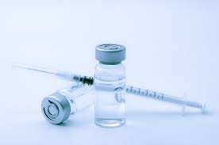




Case Overview
Executive Summary
Quantitative analysis
Methodology
Recommendations
Conclusion
Case Overview
CONTEXT
GAP
The Bill and Melinda Gates foundation focuses on
Fighting diseases and improving people’s health
Makes decisions accordingly to maximize health impact
Need to analyze the dataset and develop a methodology to prioritize vaccine distribution
Understand trends in population growth and vaccine coverage, along with any additional factors that affect health impact
There is a need to understand factors that influence health impact
There is a need to identify major priority areas to aid decision making
KEY QUESTIONS
What are the key differences between the provided datasets?
What additional factors affect health impact?
What are the countries and vaccines to prioritize?

Slide 5
Agenda
Case overview
Executive Summary
Quantitative analysis
Methodology
Recommendations
Conclusion

Slide 6
Case Overview
Executive Summary
Quantitative analysis
Methodology
Recommendations
Conclusion
Executive Summary
Quantitative Analysis and Modeling
For most of the regions, WHO (UN) population is slightly less than IHME population with relatively higher differences for a few countries
For <5-Yr-Olds, IHME forecasted populations are slightly higher with a few countries having variations up to 60%
For historical and forecasted periods, the variation in health impact is minimal (<10%) for WHO and IHME data sources for most of the countries (55% and 57% of counties respectively)
Solutions and Recommendations
To forecast the future WHO coverage, ARIMA model seems to be a good method based on the error value
Proposed methodology to estimate health impact which includes key factors such as Cases Averted, Existing Vaccine Coverage, Health Performance Index and Vaccine Purchase Capability can help the Gates Foundation prioritize better
Based on the proposed methodology, both WHO and IHME datasets have 9 out of the 10 top countries to be prioritized in common
If herd impact is considered, there are significant differences in countries to be prioritized both the data sources. Hence, selecting the data source is crucial for prioritization
IHME can be prioritized over WHO’s data source given its robust methodology and holistic view of vaccine forecast and macro-economic factors
Majority of the countries to be prioritized are from Africa, followed by Asia
HiB3 vaccine is to be prioritized first followed by PCV3, MCV2 and RotaC based on Cases Averted

Slide 7
Agenda
Case overview
Executive Summary
Quantitative analysis
Methodology
Recommendations
Conclusion

Slide 8
For most of the regions, WHO (UN) population is slightly less than IHME population with relatively higher differences for few countries
Case overview
Executive Summary
Case overview
Recommendations
Quantitative analysis
Recommendations
Quantitative analysis
Methodology
Methodology
Conclusion
Conclusion
WHO (UN) vs IHME populations for Historical data (1980-2019)
for countries >5% variation
All age groups
20%
10%
0%
-10%
-60%
-55%
Comoros
Indonesia
Cambodia
Lesotho
Benin
Afghanistan
Moldova
Sudan
Madagascar
WHO (UN) vs IHME populations for Forecasted data (2020-2030)
for countries >5% variation
20%
0%
-20%
-80%
-75%
Syria
Comoros
Congo
Mauritania
Somalia
Djibouti
Bhutan
Eritrea
*The percentages are calculated as (WHO Forecasts/ IHME Forecasts) -1
Notes:
Add footnotes explaining what the percentages denote who fc / ihme fc -1

Slide 9
Executive Summary
Case overview
Recommendations
Quantitative analysis
Recommendations
Quantitative analysis
Methodology
Methodology
Conclusion
Case overview
Conclusion
For <5-Year-Olds, IHME forecasted populations are slightly higher with a few countries having variations up to 60%
<5-year-old
WHO (UN) vs IHME populations for Historical data (1980-2019)
for countries >5% variation
10%
0%
-10%
-70%
-64%
Angola
Afghanistan
Sao Tome and Principe
Kenya
Djibouti
Cambodia
South Sudan
Yemen
Eritrea
WHO vs IHME populations for Forecasted data (2020-2030)
for countries >5% variation
Syria
Congo
Comoros
Central African Republic
Sao Tome and Principe
Bolivia
Afghanistan
Papua New Guinea
Djibouti
Eritrea
*The percentages are calculated as (WHO Forecasts/ IHME Forecasts) -1
Notes:
Add footnotes explaining what the percentages denote

Slide 10
Case overview
Executive Summary
Case overview
Recommendations
Quantitative analysis
Recommendations
Quantitative analysis
Methodology
Methodology
Conclusion
Conclusion
For 55% of the countries, the variation in health impact is minimal (<10%) for WHO and IHME data sources for historical period
# Countries by % variation in Health Impact between WHO and IHME
Top 10 countries to be prioritized based on health impact
Historical data (1980-2017)
Rank | WHO | Health impact | IHME | Health impact
1 | India (ASIA) | 1053 | India (ASIA) | 909
2 | Indonesia (ASIA) | 482 | Indonesia (ASIA) | 388
3 | Bangladesh (ASIA) | 212 | Bangladesh (ASIA) | 173
4 | Viet Nam (ASIA) | 159 | Viet Nam (ASIA) | 162
5 | Pakistan (ASIA) | 150 | Pakistan (ASIA) | 126
6 | Myanmar (ASIA) | 80 | Myanmar (ASIA) | 93
7 | Tanzania (AFRICA) | 65 | Korea, North (ASIA) | 88
8 | Syria (ASIA) | 53 | Syria (ASIA) | 60
9 | Korea, North (ASIA) | 51 | Tanzania (AFRICA) | 59
10 | Ethiopia (AFRICA) | 44 | Ukraine (EUROPE) | 53
Countries where there is a prioritization difference between WHO and IHME
<10%
10% to 20%
20% to 30%
30% to 40%
40% to 50%
>50%
Calculation of Health Impact using existing methodology
Population * Coverage % * Aversion rate %
UN population has been used to estimate the Health impact using WHO data source
Health impact based on Historical data (1980 to 2017)

Slide 11
Case overview
Executive Summary
Case overview
Recommendations
Quantitative analysis
Recommendations
Quantitative analysis
Methodology
Methodology
Conclusion
Conclusion
For 57% of the countries, the variation in health impact is minimal (<10%) for WHO and IHME data sources for forecasted period
# Countries by % variation in Health Impact between WHO and IHME
Top 10 countries to be prioritized based on health impact
Forecast data (2018-2030)
Rank | WHO | Health impact (M) | IHME | Health impact (M)
1 | India (ASIA) | 2266 | India (ASIA) | 2291
2 | Indonesia (ASIA) | 637 | Indonesia (ASIA) | 613
3 | Bangladesh (ASIA) | 431 | Bangladesh (ASIA) | 389
4 | Pakistan (ASIA) | 349 | Nigeria (AFRICA) | 337
5 | Ethiopia (AFRICA) | 242 | Pakistan (ASIA) | 327
6 | Viet Nam (ASIA) | 210 | Ethiopia (AFRICA) | 286
7 | Congo, Dem. Rep. (AFRICA) | 207 | Viet Nam (ASIA) | 219
8 | Nigeria (AFRICA) | 197 | Tanzania (AFRICA) | 140
9 | Tanzania (AFRICA) | 145 | Cameroon (AFRICA) | 137
10 | Myanmar (ASIA) | 126 | Myanmar (ASIA) | 127
Countries where there is a prioritization difference between WHO and IHME
<10%
10% to 20%
20% to 30%
30% to 40%
>40%
Calculation of Health Impact using existing methodology
Population * Coverage % * Aversion rate %
UN population has been used to estimate the Health impact using WHO data source
Health impact based on Forecast data (2018 to 2030)

Slide 12
Agenda
Case overview
Executive Summary
Quantitative analysis
Methodology
Recommendations
Conclusion

Slide 13
Case overview
Case overview
Recommendations
Executive Summary
Quantitative analysis
Recommendations
Quantitative analysis
Methodology
Methodology
Conclusion
Conclusion
ARIMA model can help forecast the future coverage for WHO based on the error value
Illustration of Forecast Method per vaccine
KNN CLUSTERING
FORECASTING MODEL FITTING
CLUSTER 1
CLUSTER 1
ARIMA
HOLT-Winters
ARMA
Last 5 year moving average
74 Gavi countries
Coverage of one country per cluster is forecasted and taken as a representation of the countries in the cluster
ARIMA model is used to forecast the coverage values based on the historical at a country level per vaccine
CLUSTER 2
CLUSTER 2
.
.
.
.
Countries were clustered based on Income group, Gavi classification, Financial ranking, Health system rank and the coverage rate trend of the vaccine
The coverage rates of countries within a cluster follow the same trend as they are classified into same cluster
CLUSTER N

Slide 14




Executive Summary
Case overview
Recommendations
Case overview
Quantitative analysis
Recommendations
Quantitative analysis
Methodology
Methodology
Conclusion
Conclusion
Other key factors to estimate health impact help with better prioritization of vaccines and countries
Descriptions
Prioritization Impact
Calculation/Source
A. AVERTED CASES
# cases averted as a function of population, vaccine coverage and normalized aversion rate (including cases, deaths and DALY’s)
Countries with high # Averted cases would be prioritized
# Averted cases = Population * Coverage % ¹ *
Normalized aversion %
Normalized aversion %² = (10%)C + (30%)D + (60%)DALY
B. VACCINE COVERAGE %
Percentage of vaccine coverage in a country at the beginning of a year
Countries with low vaccine coverage would be prioritized
Coverage rate in a particular country for a particular vaccine at the beginning of the year
C. HEALTH PERFORMANCE INDEX³
Country rank based on their health performances and used as a focus parameter
Countries with lower health performance index ranking would be prioritized
Country wise health performance ranking based on the report on Overall performance system of countries by WHO
D. PURCHASE CAPABILITY
Countries are bucketed based on their economic status and their financial risk protection ability
Countries with higher purchasing capability would be prioritized
Purchasing capability based on factors like world_bank_income_group, gavi_classification
for each country
Coverage % for WHO has been forecasted based on ARIMA model. No changes in coverage % for IHME.
C = cases_averted_rate; D = deaths_averted_rate; DALY = dalys_averted_rate. Weightages based on the Gates foundations priorities.
Source - https://www.who.int/healthinfo/paper30.pdf

Slide 15
Case overview
Executive Summary
Case overview
Recommendations
Quantitative analysis
Recommendations
Quantitative analysis
Methodology
Methodology
Conclusion
Conclusion
Final prioritization is based on the total score calculated for each of the 4 factors
Table showing the values for each of the 4 factors for 10 countries
Methodology:
Each country is given a factor score based on their corresponding value for the 4 metrics
In this example, 10 countries are given a score between 1 and 5 for each factor
Each factor is given equal weightage to calculate the final score
The average of this final scores across years and vaccines is considered to get to the overall prioritizations
Table showing the prioritization based on the final score

Slide 16
Agenda
Case overview
Executive Summary
Quantitative analysis
Methodology
Recommendations
Conclusion

Slide 17
Case overview
Recommendations
Executive Summary
Quantitative analysis
Recommendations
Quantitative analysis
Methodology
Methodology
Conclusion
Conclusion
Based on the proposed methodology, both the datasets have 9 common countries out of the 10 top countries to be prioritized
All vaccines
(2020-2030)
Top 10 countries to be prioritized based on health impact
WHO
IHME
Rank | Country | Individual factor scores | Coverage (%) | Health performance index | Purchasing capability | Total
 |  | Averted Cases | Coverage (%) | Health performance index | Purchasing capability | Total
1 | Angola (AFRICA) | 9 | 8 | 9 | 11 | 37
2 | Congo, Dem. Rep. (AFRICA) | 10 | 6 | 10 | 9 | 35
3 | Ethiopia (AFRICA) | 10 | 7 | 9 | 9 | 35
4 | Chad (AFRICA) | 7 | 10 | 9 | 9 | 34
5 | Afghanistan (ASIA) | 9 | 8 | 8 | 9 | 34
6 | Nigeria (AFRICA) | 10 | 9 | 10 | 5 | 34
7 | Somalia (AFRICA) | 7 | 10 | 9 | 9 | 35
8 | Niger (AFRICA) | 10 | 6 | 8 | 9 | 33
9 | Mali (AFRICA) | 9 | 7 | 8 | 9 | 33
10 | Viet Nam (ASIA) | 8 | 9 | 7 | 11 | 35
Rank | Country | Individual factor scores | Coverage (%) | Health performance index | Purchasing capability | Total
 |  | Averted Cases | Coverage (%) | Health performance index | Purchasing capability | Total
1 | Angola (AFRICA) | 9 | 9 | 9 | 11 | 38
2 | Congo, Dem. Rep. (AFRICA) | 10 | 9 | 10 | 9 | 37
3 | Ethiopia (AFRICA) | 10 | 9 | 9 | 9 | 36
4 | Afghanistan (ASIA) | 9 | 9 | 8 | 9 | 34
5 | Chad (AFRICA) | 9 | 7 | 9 | 9 | 34
6 | Mali (AFRICA) | 9 | 7 | 8 | 9 | 33
7 | Nigeria (AFRICA) | 10 | 9 | 10 | 5 | 33
8 | Somalia (AFRICA) | 8 | 7 | 9 | 9 | 33
9 | Niger (AFRICA) | 10 | 6 | 8 | 9 | 32
10 | Liberia (AFRICA) | 4 | 7 | 10 | 9 | 30
Countries that are not common between top 10 prioritized countries for WHO and IHME

Slide 18
Case overview
Recommendations
Executive Summary
Quantitative analysis
Recommendations
Quantitative analysis
Methodology
Methodology
Conclusion
Conclusion
When herd immunity is considered, selecting the data source is crucial as the prioritized countries vary majorly between IHME and WHO
PCV3 vaccine
(2020-2030)
Rank | Herd Immunity at 50% | Coverage (%) | Herd Immunity at 60% | Purchasing capability | Herd Immunity at 70%
 | WHO | IHME | WHO | IHME | WHO | IHME
1 | Angola (AFRICA) | Viet Nam (ASIA) | Angola (AFRICA) | Angola (AFRICA) | Angola (AFRICA) | Angola (AFRICA)
2 | Congo, Dem. Rep. (AFRICA) | Angola (AFRICA) | Congo, Dem. Rep. (AFRICA) | Viet Nam (ASIA) | Congo, Dem. Rep. (AFRICA) | Viet Nam (ASIA)
3 | Ethiopia (AFRICA) | Somalia (AFRICA) | Ethiopia (AFRICA) | Ethiopia (AFRICA) | Ethiopia (AFRICA) | Ethiopia (AFRICA)
4 | Afghanistan (ASIA) | Chad (AFRICA) | Afghanistan (ASIA) | Somalia (AFRICA) | Afghanistan (ASIA) | Somalia (AFRICA)
5 | Chad (AFRICA) | Nigeria (AFRICA) | Chad (AFRICA) | Chad (AFRICA) | Chad (AFRICA) | Chad (AFRICA)
6 | Nigeria (AFRICA) | Guinea (AFRICA) | Nigeria (AFRICA) | Nigeria (AFRICA) | Nigeria (AFRICA) | Afghanistan (ASIA)
7 | Mali (AFRICA) | Central African Republic (AFRICA) | Mali (AFRICA) | Afghanistan (ASIA) | Mali (AFRICA) | Nigeria (AFRICA)
8 | Somalia (AFRICA) | Tajikistan (ASIA) | Somalia (AFRICA) | Guinea (AFRICA) | Somalia (AFRICA) | Mali (AFRICA)
9 | Mozambique (AFRICA) | Sri Lanka (ASIA) | Mozambique (AFRICA) | Central African Republic (AFRICA) | Mozambique (AFRICA) | Guinea (AFRICA)
10 | Niger (AFRICA) | India (ASIA) | Niger (AFRICA) | Indonesia (ASIA) | Niger (AFRICA) | Central African Republic (AFRICA)
Key Insights
For WHO, the priority order of the countries consistent across various herd immunity thresholds
As the herd immunity threshold increases, more African countries are prioritized over Asian countries, which implies Asian countries have higher coverages compared to those of African countries

Slide 19
Agenda
Case overview
Executive Summary
Quantitative analysis
Methodology
Recommendations
Conclusion

Slide 20
Case overview
Recommendations
Quantitative analysis
Recommendations
Quantitative analysis
Methodology
Methodology
Conclusion
Executive Summary
Conclusion
IHME dataset is recommended based on its robust methodology and holistic view of vaccine forecast and macro-economic factors
Prioritization decisions(till 2030)
IHME Vaccine Forecast
IHME Forecasts are based on UHC coverage index which considered 9 key metrics like infectious diseases, noncommunicable diseases, service capacity, access etc.
Financial status of the countries is not considered in this forecast which turns out to be a biggest challenge; Hence we incorporated this factor in our methodology
By country*
By vaccine**
Angola (AFRICA)
Congo, Dem. Rep. (AFRICA)
Ethiopia (AFRICA)
Afghanistan (ASIA)
Chad (AFRICA)
Mali (AFRICA)
Nigeria (AFRICA)
Somalia (AFRICA)
Niger (AFRICA)
Liberia (AFRICA)
Hib3
PCV3
MCV2
RotaC
Additional scope
Identification of weights to parameters through trends in historical data for strategic determination of focus areas
Additional research and data supplements
Historic vaccine investment data in-order to assess the weights among the 4 parameters
Countries’ economic status
Health performance information on countries
* Based on proposed methodology and IHME data set
** Based on number of cases averted
Notes:
Consider IHME data set for robust and holistic view of vaccine forecast and macro-economic factors

Slide 21
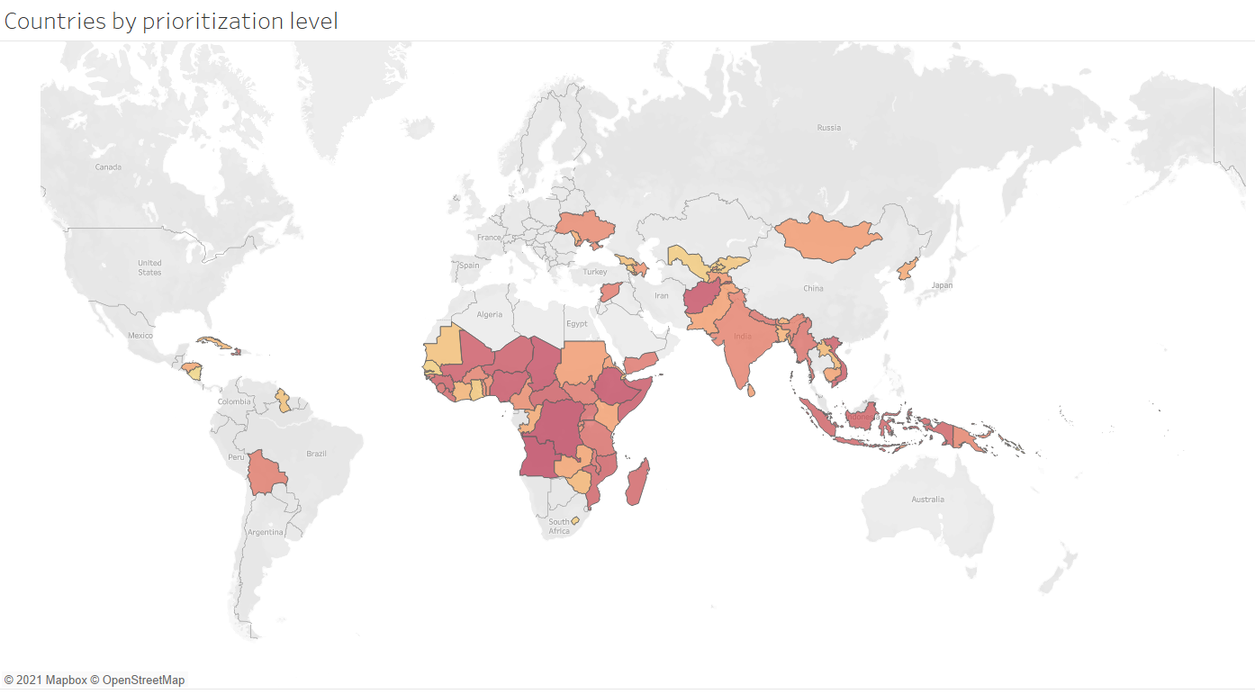
Case overview
Recommendations
Quantitative analysis
Recommendations
Quantitative analysis
Methodology
Methodology
Conclusion
Executive Summary
Conclusion
Most of the high priority countries are from African region
Country Prioritization Dashboard
Countries by prioritization level
Highest Priority
Prioritized countries
Lowest Priority
Countries were prioritized based on our methodology considering all the 4 key parameters using available IHME data

Slide 22
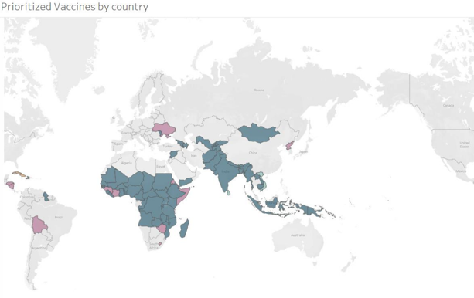


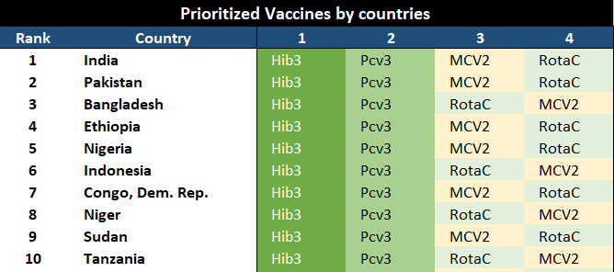
Executive Summary
Recommendations
Quantitative analysis
Recommendations
Quantitative analysis
Methodology
Methodology
Conclusion
Case overview
Conclusion
Hib3 can be prioritized in most countries (59 of 74) followed by PCV3
Vaccine Prioritization Dashboard
Vaccine with highest priority across countries
Highest
Priority Vaccine
Vaccine prioritization
Vaccine prioritization is done based on the cases averted metric using IHME dataset

Slide 23
THANK YOU

